Slide 1


NEURAL NETWORKS
Fruit Health Detector

Slide 2
CONTENTS
01
Project Overview
02
Examples for Healthy and Rotten Fruit
03
Code Screenshots and Output Examples

Slide 3
01
Project Overview

Slide 4

Fruit Health Detection
This neural network is made to detect the health of the fruit, based on the appearance of specific features on the outer layer of the fruit itself, for example: Darker colors.
The project takes samples of images from three kinds of fruits (Apples, oranges and bananas), and runs them through a filter to detect whether the fruit will be classified as healthy or rotten.

Slide 5
02
Examples for Healthy and Rotten Fruit

Slide 6
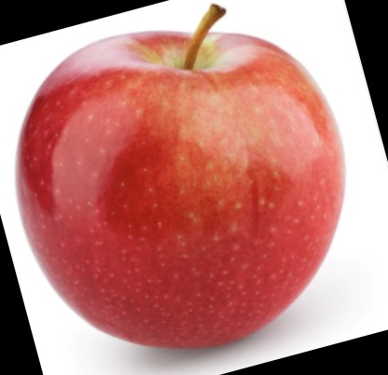
Healthy fruit example
EXAMPLE
EXAMPLE
The color of the fruit has a shine to it, which means the fruit has more possibility to be healthy.
The stem of the apple has a healthy structure and no darkness in it, meaning it could be passed as healthy.
EXAMPLE
The texture of the apple has no dents nor breaks in it, adding more confirmation that the apple is healthy.

Slide 7
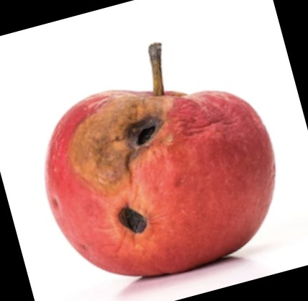
Rotten fruit example
EXAMPLE
EXAMPLE
There is a darker color and apparent change in the outer layer of the fruit, which is one of the features needed to identify the fruit as rotten.
Another example is the change of texture of the layer of the fruit, causing the fruit to be also qualified as rotten.
EXAMPLE
A third example is the existence of dark patches that are dented inwards, another feature that adds the fruit to the rotten list.

Slide 8
03
Code Screenshots and Output Examples

Slide 9
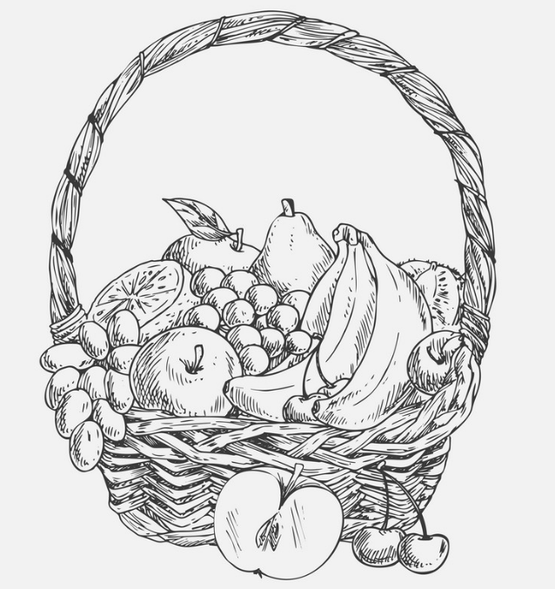
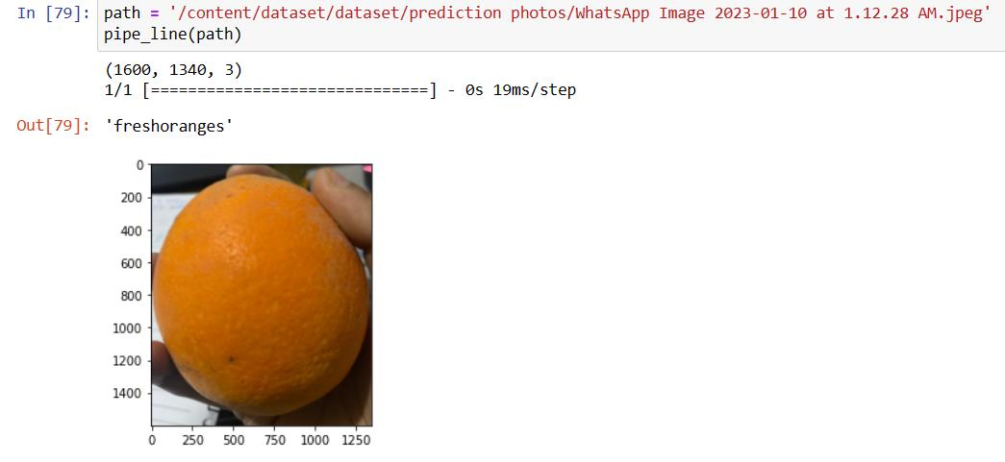
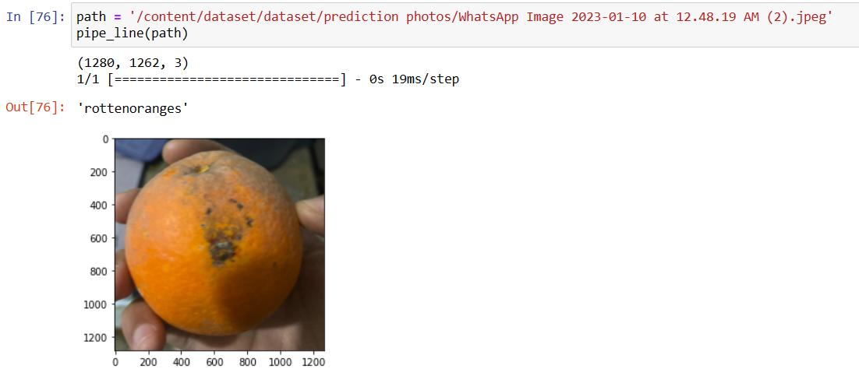
OUTPUT SCREENSHOTS

Slide 10
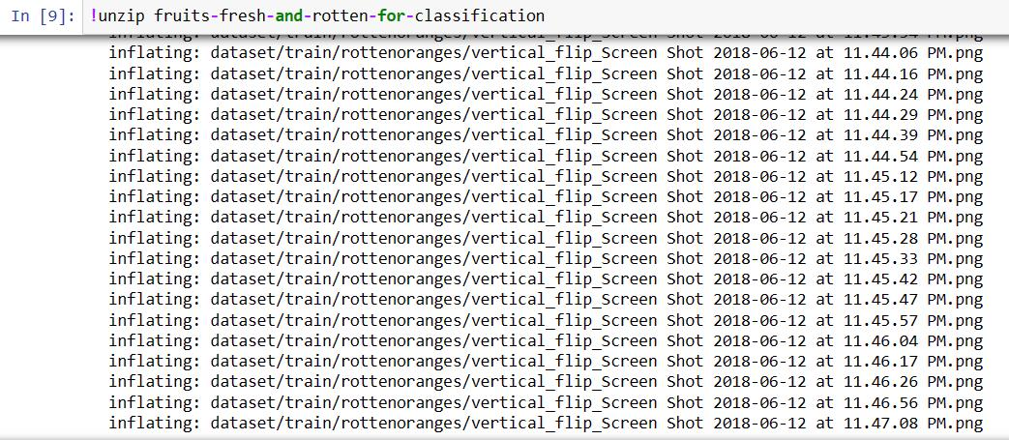
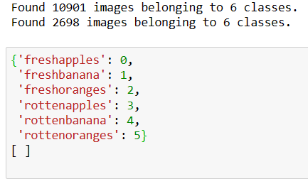
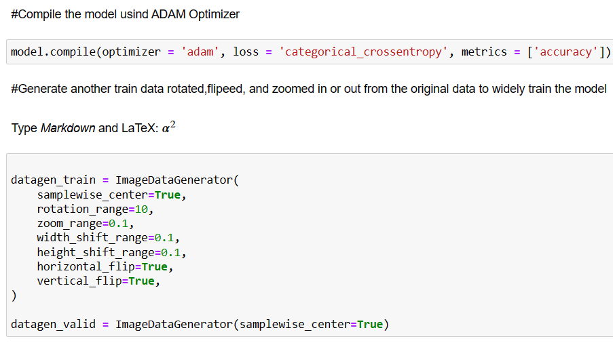
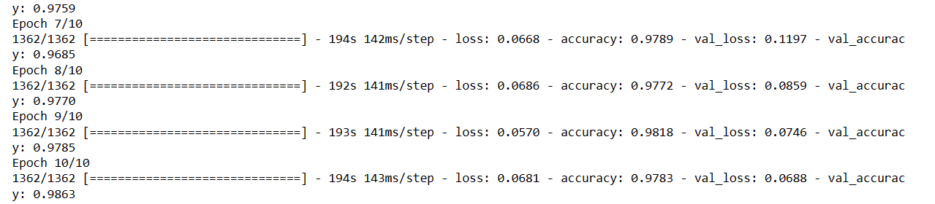
Some Code Screenshots
CODE

Slide 11

Thank you

